Slide 1
2-2 TCP/IP PROTOCOL SUITE
TCP/IP (Transmission Control Protocol/Internet protocol) is a protocol suite (a set of protocols organized in different layers) used in the Internet today.
The original TCP/IP protocol suite was defined as having
  four layers: host-to-network (or network interface), internet, transport, and application. However, when TCP/IP is compared to OSI, we can say that the TCP/IP protocol suite is made of
  five layers: physical, data link, network, transport, and application.

Slide 2
Figure 2.4: Layers in the TCP/IP protocol suite
1.<number>
Notes:
1.#

Slide 3

Figure 2.16 TCP/IP protocol suite and OSI model

Slide 4
TCP/IP protocol suites
Network layer – IP
Transport layer – TCP, SCTP and UDP
Application layer – WWW, FTP, …

Slide 5
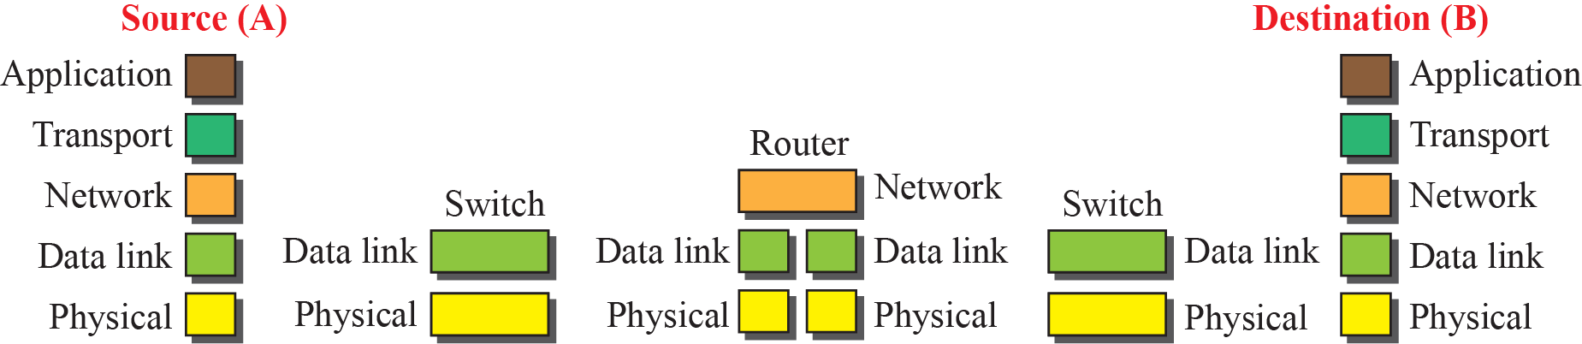
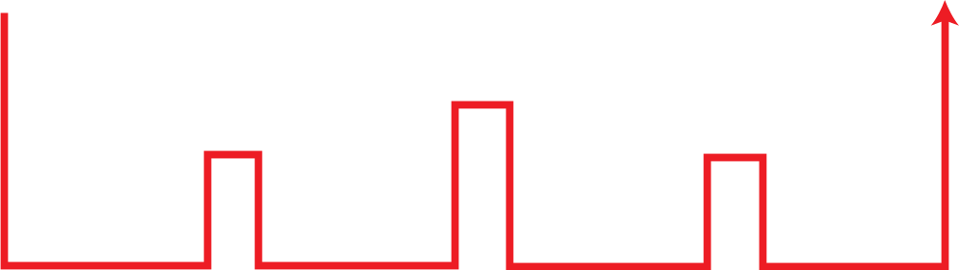
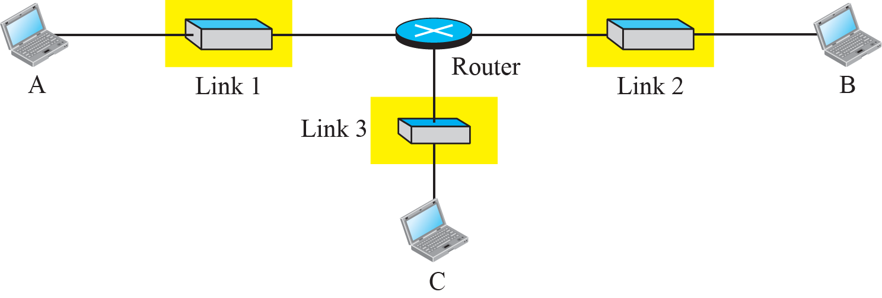
Communication through an internet
1.<number>
Notes:
1.#

Slide 6
Devices in Internet
End hosts implement all five layers
Router involves three layers:
  One network layer,
  N-set of data link layer and physical layer,
    One for each connected link: Each link may use different link-layer and physical-layer protocols.
Link switch involves two layers:
  Data link and physical layer.

Slide 7
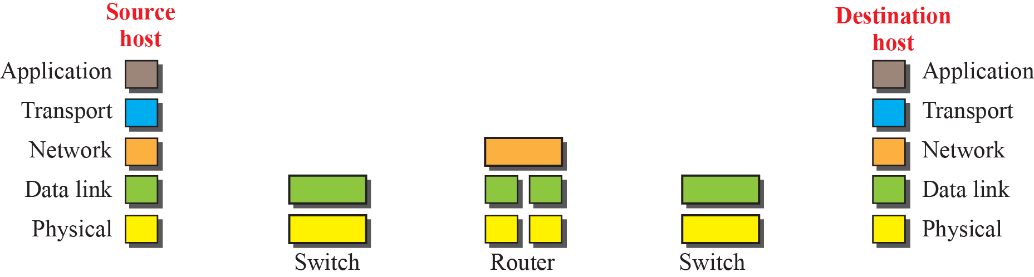
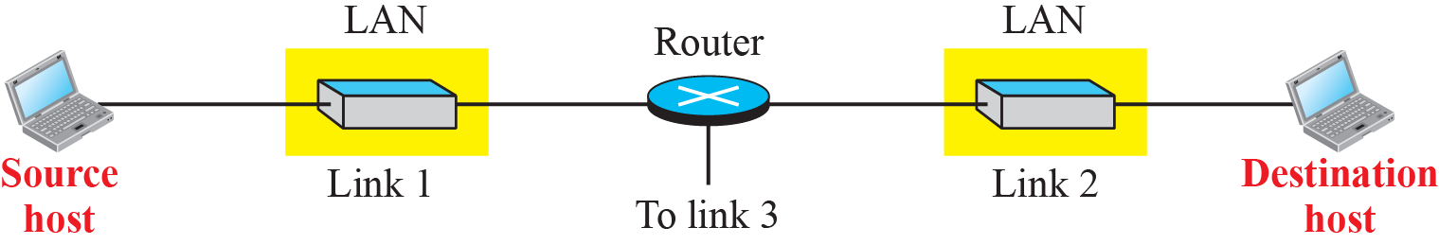
Logical connections between layers in TCP/IP
Logical connections
1.<number>
Notes:
1.#

Slide 8
Logic connection
Dialog between two peers.
Logical connection can be considered as
  End-to-end: protocol units (or packets) do not change between end points
  Hop-to-hop: protocol units are changed in each hop

Slide 9

Q1. Which layers have end-to-end duty or in domain of Internet?

Slide 10
Q2. Which layers have hop-to-hop duty, or in the domain of link? A hop is a host or router.

Slide 11
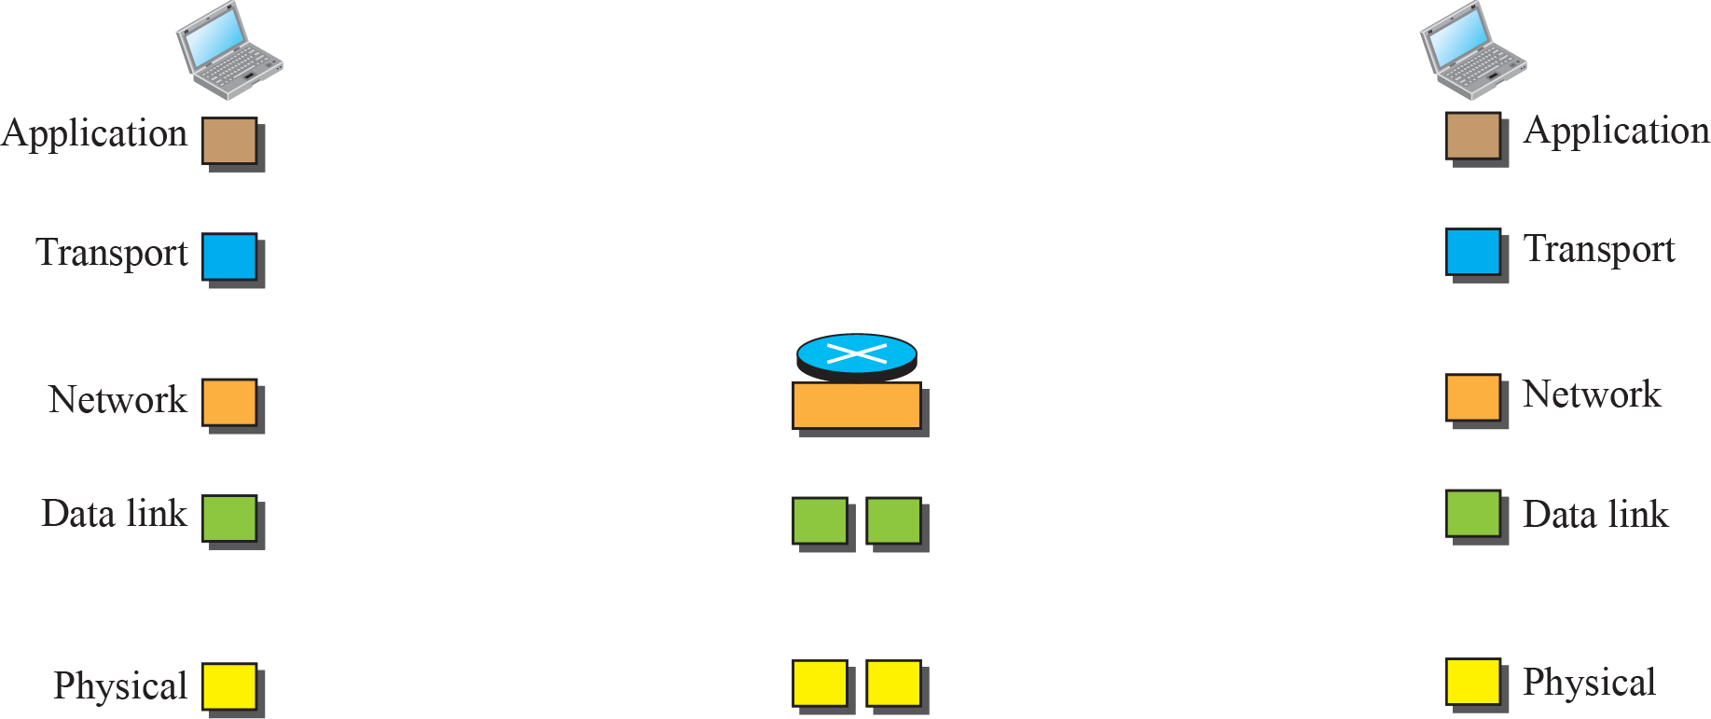
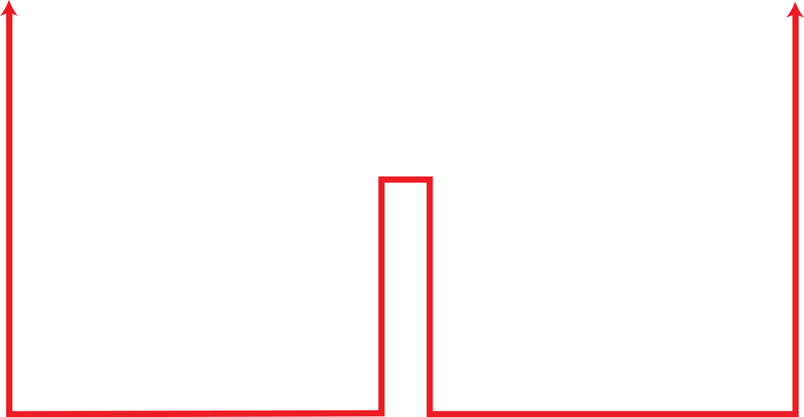
Identical objects in the TCP/IP protocol suite
Identical objects (messages)
Identical objects (segment or user datagram)
Identical objects (datagram)
Identical objects (datagram)
Identical objects (frame)
Identical objects (frame)
Identical objects (bits)
Identical objects (bits)
1.<number>
Notes:
1.#

Slide 12
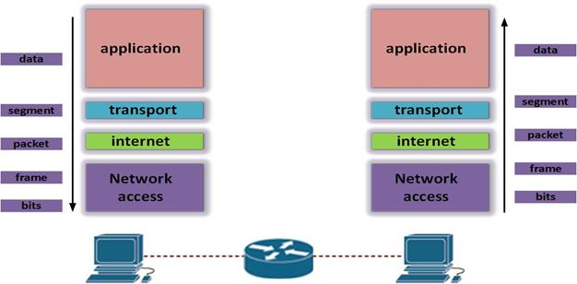
FUNCTIONS OF EACH LAYER

Slide 13

Physical Layer
The physical layer is responsible for transmitting individual bits in a frame from one node to the next.

Slide 14
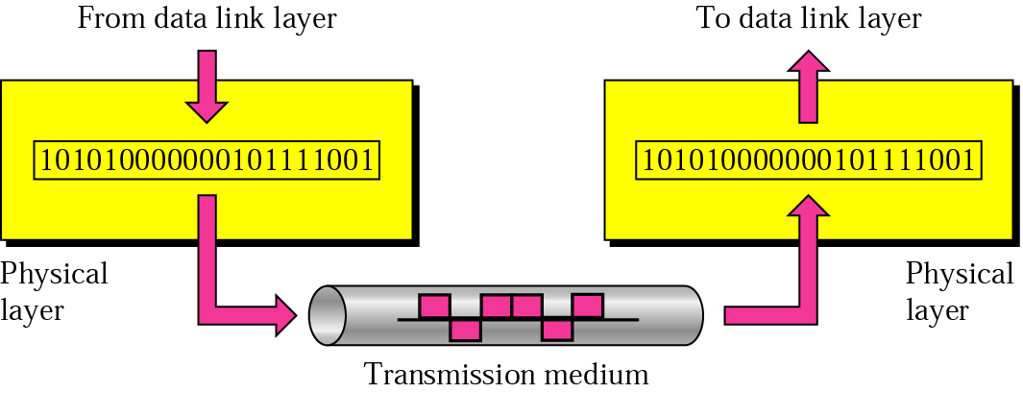
Physical layer
Physical Layer:
  Task: transmit a bit stream over a physical medium
  with electromagnetic wave.
Bit
(Logical)
Electromagnetic wave

Slide 15
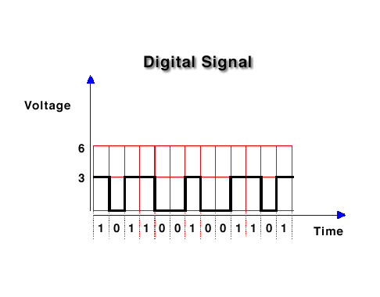
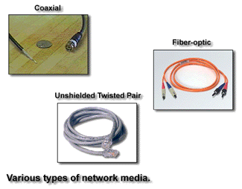
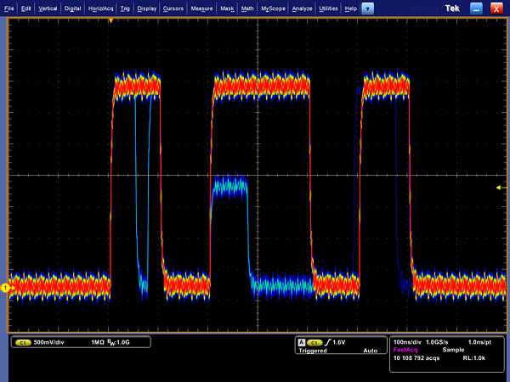
It is still logical with a hidden lower layer:
transmission media.
Logic connection units:
Bits
Physical form:
Electromagnetic waves

Slide 16
Data Link Layer
The data link layer is responsible for transmitting frames from
one node to the next.
➔ Transform the physical layer to a reliable link.

Slide 17
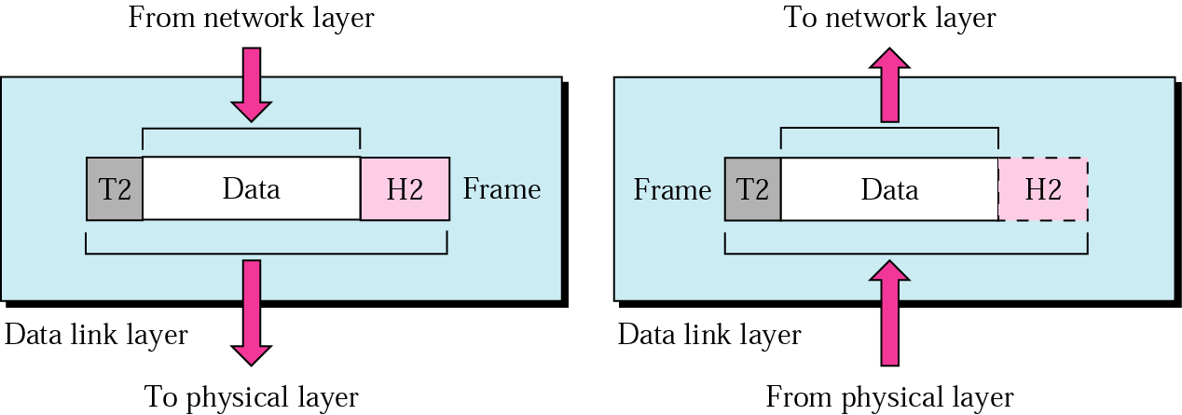
Data link layer
TCP/IP does not define any specific protocol for the data link layer. It supports all the standard and proprietary protocols.
Data link layer takes a datagram and encapsulates it in a packet called a frame.

Slide 18
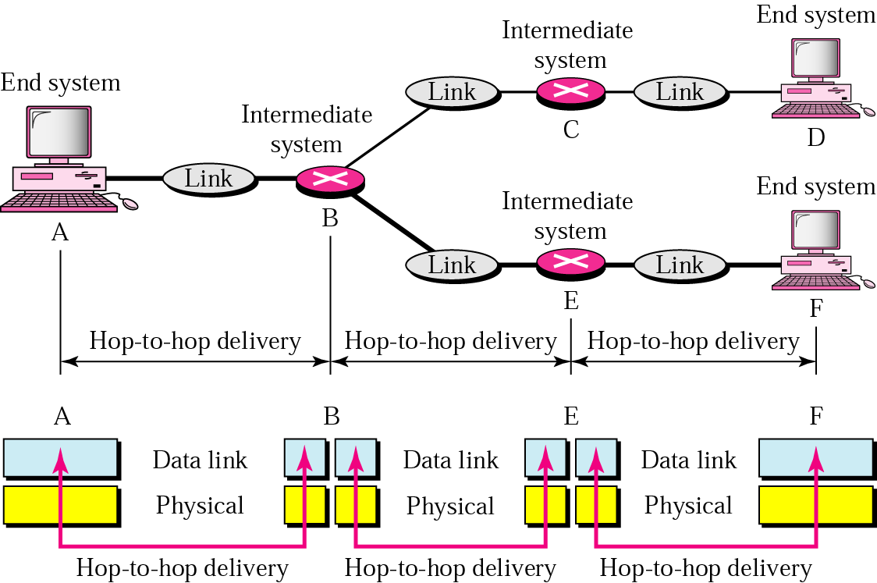
Figure 2.7 Node-to-node delivery

Slide 19
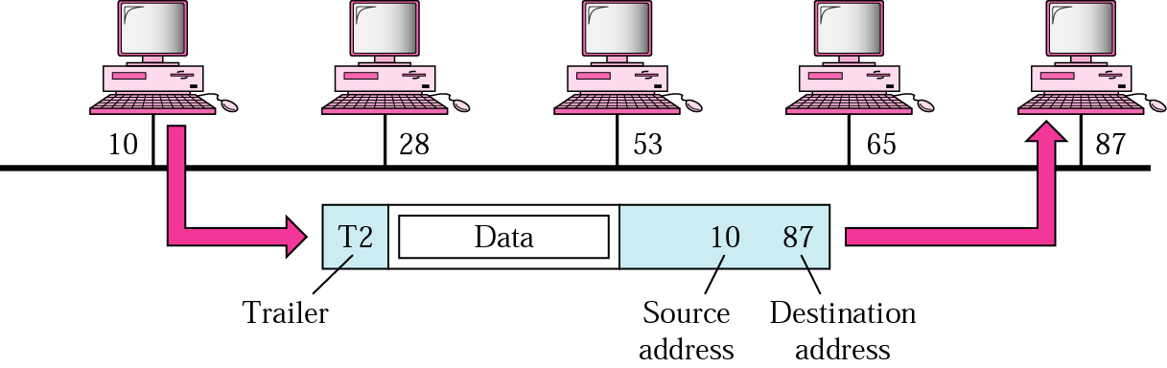
Example 1
A node with physical address 10 sends a frame to a node with physical address 87.

Slide 20
Network Layer
The network layer is responsible for the delivery of packets from the original source to the
final destination.

Slide 21
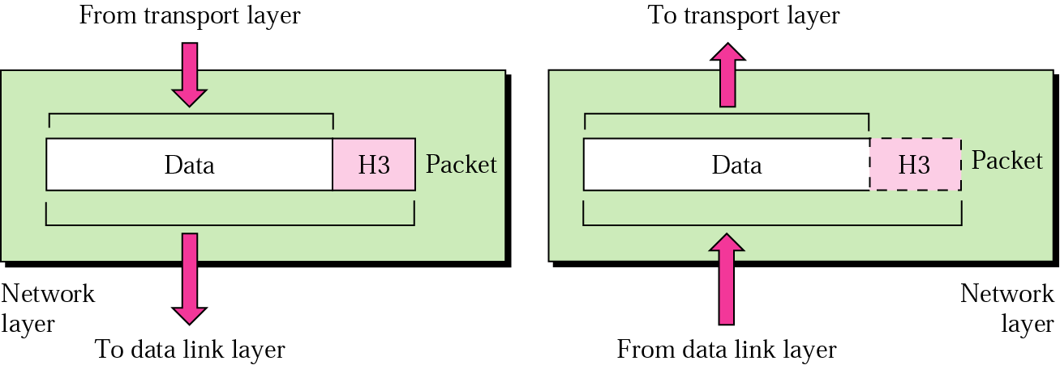
Network layer

Slide 22
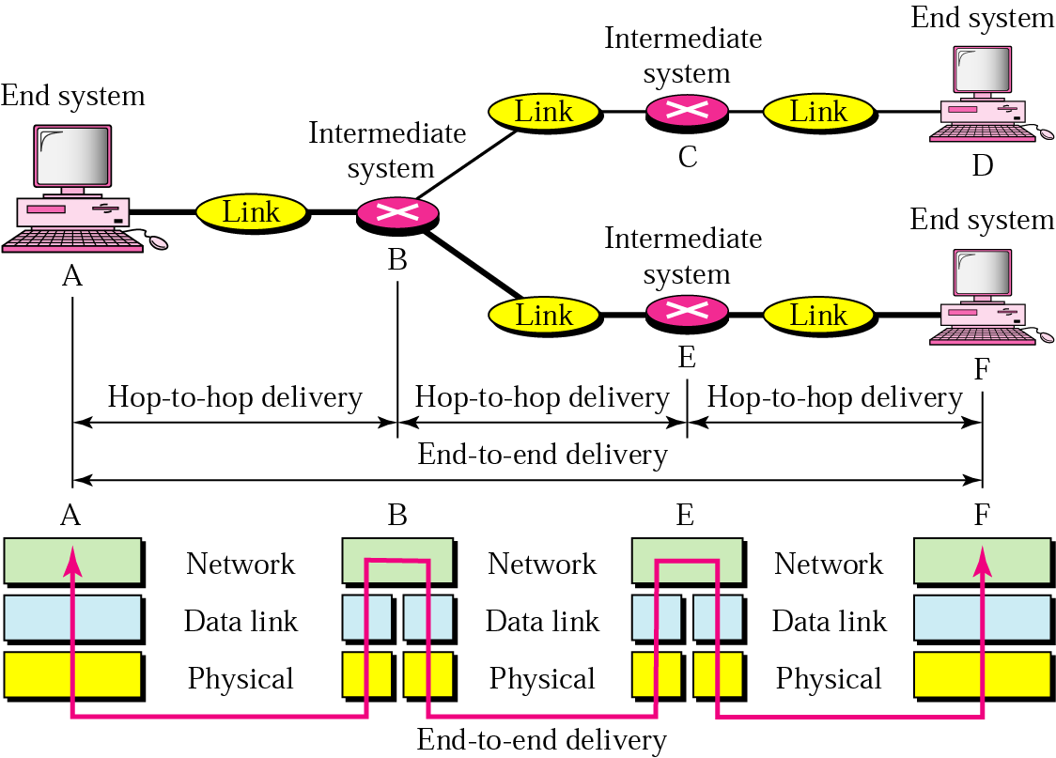
Figure 2.10 Source-to-destination delivery
Network boundary

Slide 23
Major duties
Logical addressing
  Adding logical addresses in the packet for routing over network boundary.
Routing:
  Choosing the best route for each packet
  Route and switch the packets to their final destination.

Slide 24
Example 2
In Figure 2.11 we want to send data from a node with network address A and physical address 10, located on one LAN, to a node with a network address P and physical address 95, located on another LAN.

Slide 25
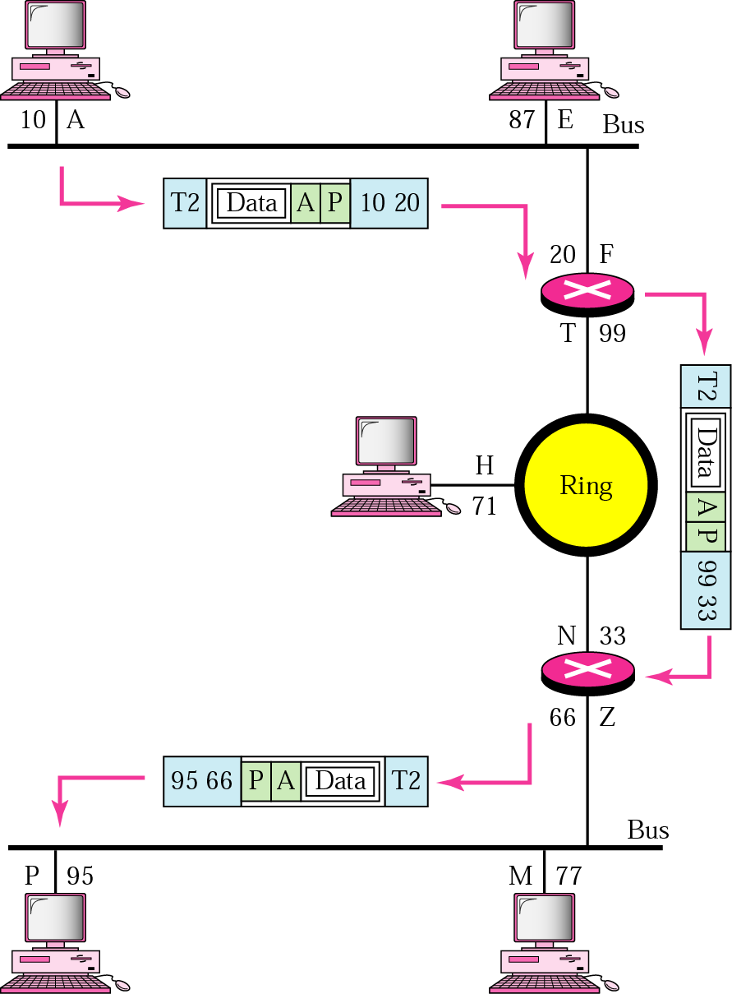
Figure 2.11 Example 2
The physical addresses only have local jurisdiction.
Use universal addresses that can pass through the LAN boundaries.
The network (logical) addresses have this characteristic.

Slide 26
Internet protocol (IP)
IP defines format of a datagram and IP address
IP is responsible for routing a packet from its source to its destination across multiple networks
Implemented in end systems and routers
Provide best-effort delivery
  No flow control, no error control and no congestion control
Unit of transportation is datagrams.
Provide unicast (one-to-one) and multicast (one-to-many) routing protocols.

Slide 27
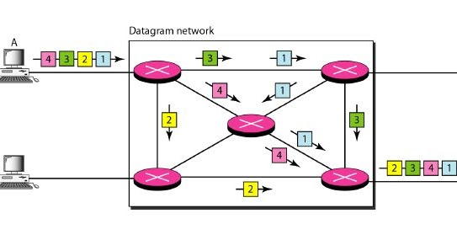
Connectionless IP
IP datagrams may arrive at receiver out of order.

Slide 28
Q3. Who are responsible to recover from errors if IP datagrams get lost?

Slide 29
Control messages
ICMP (Internet Control Message Protocol)
  A mechanism used by hosts and gateways to send notification of datagram problems back to the sender.
Internet Group message protocol (IGMP)
  Facilitate the simultaneous transmission of a message to a group of recipients.
Dynamic Host Configuration Protocol (DHCP)
  Help IP to get the network-layer address for a host.

Slide 30
Some auxiliary protocols at internet layer
ARP (Address Resolution Protocol)
  Help IP to find the link-layer address of a host or a router when its network-layer address is given.
RARP
  Given a physical address, find its Internet address.

